Slide 2
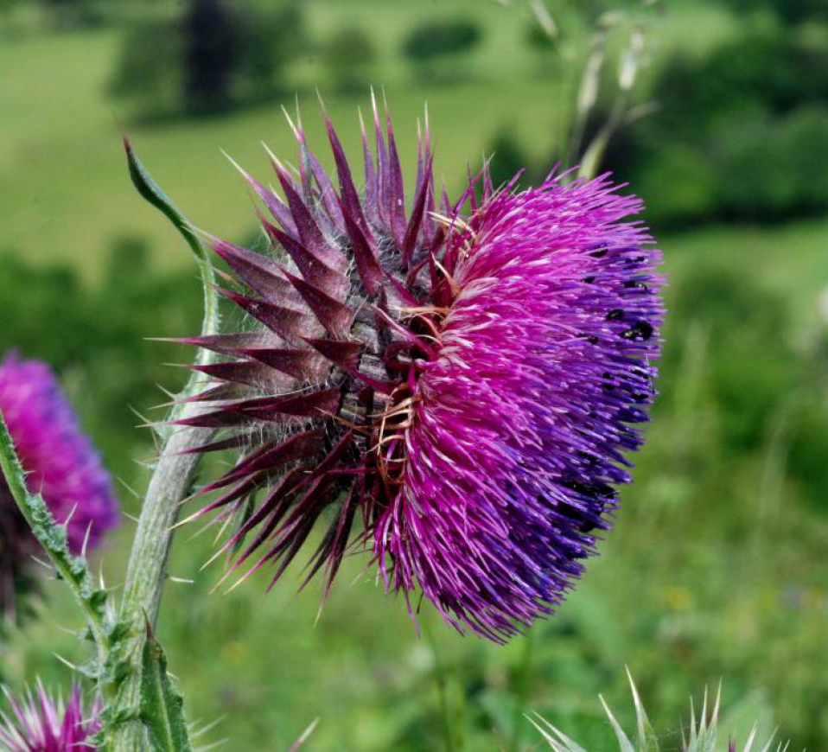
Study Species: Carduus Nutans
Seed release photo?
Invasive weed in US
Causes decrease in agricultural productivity
Managed with
Mowing
Biological control (weevil)
brc.ac.uk

Slide 3
Seed release photo?
Dispersal data helps us understand how quickly this invasive species spreads
Seed terminal velocity is a measure of how fast a seed falls.
It can be used to estimate how far dispersed seeds travel
brc.ac.uk

Slide 4
Research Questions
Is seed terminal velocity predicted by seed shape parameters?
To what extent do warming and mowing treatments change seed terminal velocity?
Can changes in terminal velocity by treatment be explained by changes in seed shape parameters?
Answered with data from seed drop experiment
Teller et al. (2014)

Slide 5
Effect of seed physical properties on terminal velocity
Research Question 1:

Slide 6
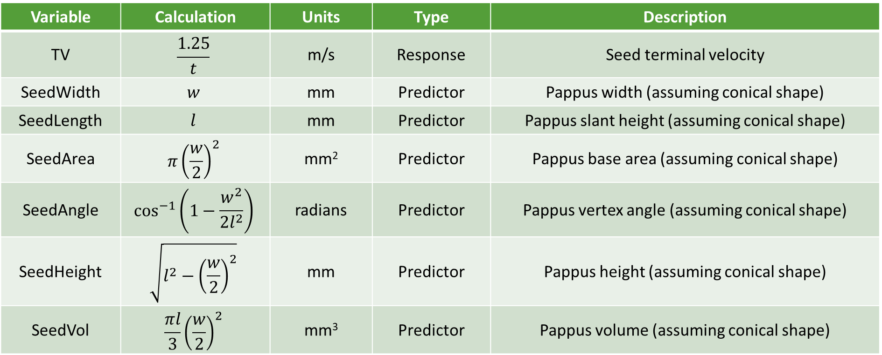
Regression variables
Variable | Calculation | Units | Type | Description
TV | $$\frac{1.25}{t}$$ | m/s | Response | Seed terminal velocity
SeedWidth | $$w$$ | mm | Predictor | Pappus width (assuming conical shape)
SeedLength | $$l$$ | mm | Predictor | Pappus slant height (assuming conical shape)
SeedArea | $$π{\left(\frac{w}{2}\right)}^{2}$$ | mm² | Predictor | Pappus base area (assuming conical shape)
SeedAngle | $$\cos^{−1}\left(1−\frac{w^{2}}{2l^{2}}\right)$$ | radians | Predictor | Pappus vertex angle (assuming conical shape)
SeedHeight | $$\sqrt{l^{2}−{\left(\frac{w}{2}\right)}^{2}}$$ | mm | Predictor | Pappus height (assuming conical shape)
SeedVol | $$\frac{πl}{3}{\left(\frac{w}{2}\right)}^{2}$$ | mm³ | Predictor | Pappus volume (assuming conical shape)

Slide 7
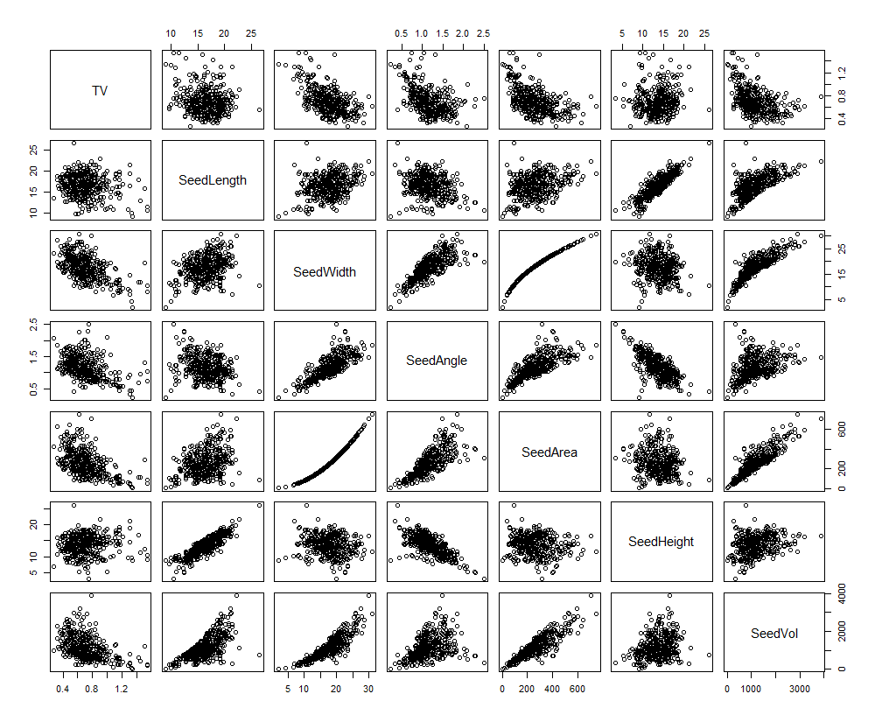
Correlations between variables
Some predictor variables are highly correlated
Occurs because some variables are calculated from other variables
Will cause multicollinearity issues
Response variable is clearly correlated with several predictors (e.g. SeedWidth, SeedAngle, SeedVol)

Slide 8
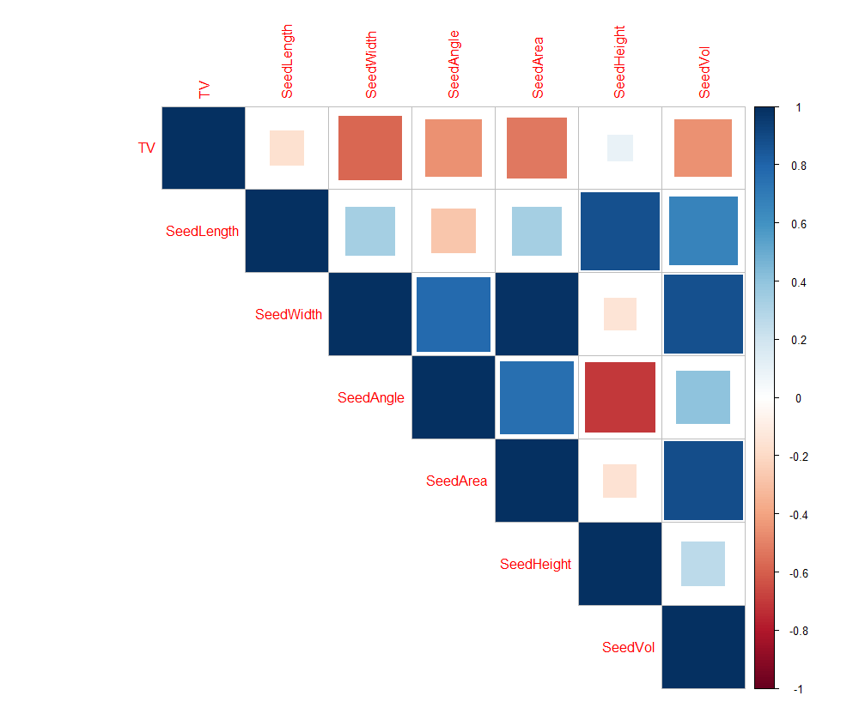
Correlations between variables
Some predictor variables are highly correlated
Occurs because some variables are calculated from other variables
Will cause multicollinearity issues
Response variable is clearly correlated with several predictors (e.g. SeedWidth, SeedAngle, SeedVol)

Slide 9
Variable selection
Variable | Estimate | Standard Error | P | Significance | VIF
(Intercept) | 1.7939155 | 0.2871889 | < 0.0001 | ***
SeedWidth | -0.0901834 | 0.0294440 | 0.00236 | ** | 232
SeedLength | 0.2323392 | 0.1394278 | 0.09650 | . | 1673
SeedArea | -0.0012359 | 0.0020885 | 0.55438 |  | 918
SeedAngle | -0.2098880 | 0.4396778 | 0.63339 |  | 291
SeedHeight | -0.2336151 | 0.1535504 | 0.12902 |  | 2709
SeedVol | 0.0003648 | 0.0001638 | 0.02653 | * | 128
Fit model using all predictors with no transformations such that:
TV ~ SeedWidth + SeedLength + SeedArea + SeedAngle + SeedHeight + SeedVol

Slide 10
Variable selection
Variable | Backward selection | Backward selection (AIC) | Bi-directional selection (AIC) | Forward selection (AIC)
(Intercept) | 1.6698759 | 1.6698759 | 1.6698759 | 1.6694531
SeedWidth | -0.1027270 | -0.1027270 | -0.1027270 | -0.0865305
SeedLength | 0.1536113 | 0.1536113 | 0.1536113 | -
SeedArea | - | - | - | 0.0021475
SeedAngle | - | - | - | -
SeedHeight | -0.1470827 | -0.1470827 | -0.1470827 | -
SeedVol | 0.0002749 | 0.0002749 | 0.0002749 | -
AIC | - | -1293.6 | -1293.6 | -1288.4
R² | 0.3921 | 0.3921 | 0.3921 | 0.3803
All coefficient estimates are highly significant at p < 0.001 (***)

Slide 11
Variable selection
Model 1
Model 2
Variable | Backward selection | Backward selection (AIC) | Bi-directional selection (AIC) | Forward selection (AIC)
(Intercept) | 1.6698759 | 1.6698759 | 1.6698759 | 1.6694531
SeedWidth | -0.1027270 | -0.1027270 | -0.1027270 | -0.0865305
SeedLength | 0.1536113 | 0.1536113 | 0.1536113 | -
SeedArea | - | - | - | 0.0021475
SeedAngle | - | - | - | -
SeedHeight | -0.1470827 | -0.1470827 | -0.1470827 | -
SeedVol | 0.0002749 | 0.0002749 | 0.0002749 | -
AIC | - | -1293.6 | -1293.6 | -1288.4
R² | 0.3921 | 0.3921 | 0.3921 | 0.3803
All coefficient estimates are highly significant at p < 0.001 (***)

Slide 12
Model selection
Both models have high multicollinearity
Worse in model 1 than in model 2
If we were to choose based on VIF alone, model 2 would be a better selection
Variable | Model 1 VIF | Model 2 VIF
(Intercept) | - | -
SeedWidth | 37 | 30
SeedLength | 70 | -
SeedArea | - | 30
SeedAngle | - | -
SeedHeight | 72 | -
SeedVol | 15 | -

Slide 13
Model selection
Model 2
Model 1
Variable | 1 | 2 | 3 | 4 | 5 | 6
SeedWidth | * | * | * | * | * | *
SeedLength |  |  | * | * | * | *
SeedArea |  | * | * |  | * | *
SeedAngle |  |  |  |  |  | *
SeedHeight |  |  |  | * | * | *
SeedVol |  |  |  | * | * | *
R² | 0.3292141 | 0.3836799 | 0.3845918 | 0.3987089 | 0.3989259 | 0.3993030
If we can only choose two variables, we should select SeedWidth and SeedArea.
Model 2 seems like the better choice because it yields a large decrease in multicollinearity for only a small decrease in R².

Slide 14

Model selection
If SeedArea is calculated only from SeedWidth as ${π\left(\frac{w}{2}\right)}^{2}$, then why not use a single-variable polynomial regression instead of two variables?
Furthermore, is the quadratic term even necessary?
Variable | Model 2 VIF
(Intercept) | -
SeedWidth | 30
SeedLength | -
SeedArea | 30
SeedAngle | -
SeedHeight | -
SeedVol | -
Model 3: TV ~ SeedWidth
Model 4: TV ~ SeedWidth + I(SeedWidth^2)

Slide 15
Model selection
All terms are highly significant
Addition of the quadratic term reduces the amount of unexplained variance
Model 4 is likely the better choice, but we should check the model diagnostics to make sure
Value | Model 3 | Model 4
Intercept p-value | < 0.0001 | < 0.0001
SeedWidth p-value | < 0.0001 | < 0.0001
I(SeedWidth^2) p-value | - | < 0.0001
AIC | -1259.1 | -1288.4
R² | 0.3274 | 0.3803

Slide 16
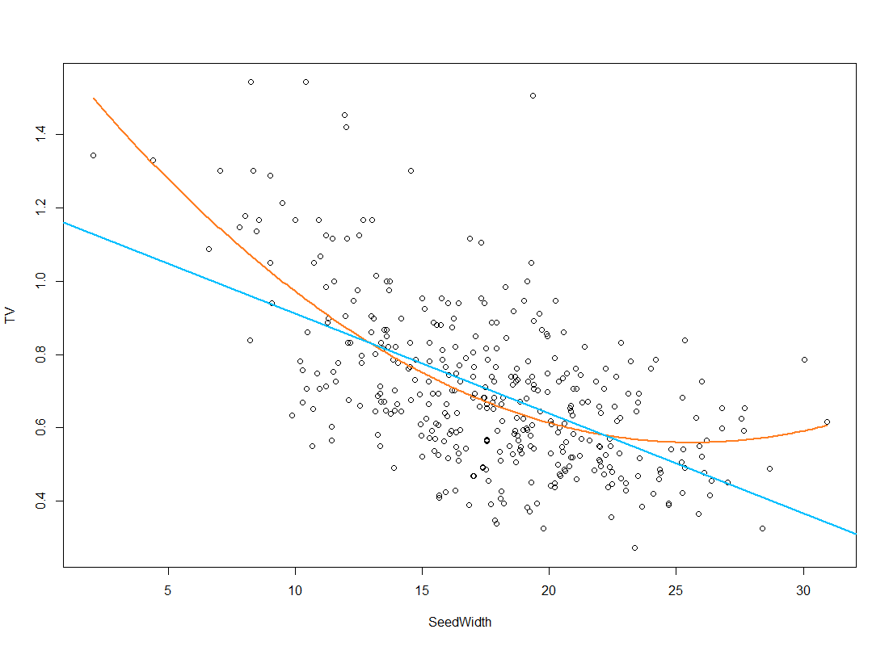
Model diagnostics
Clear pattern of curvature in the data
Polynomial model (model 4) seems to fit better than strictly linear model (model 3)
Model 4
Model 3

Slide 17
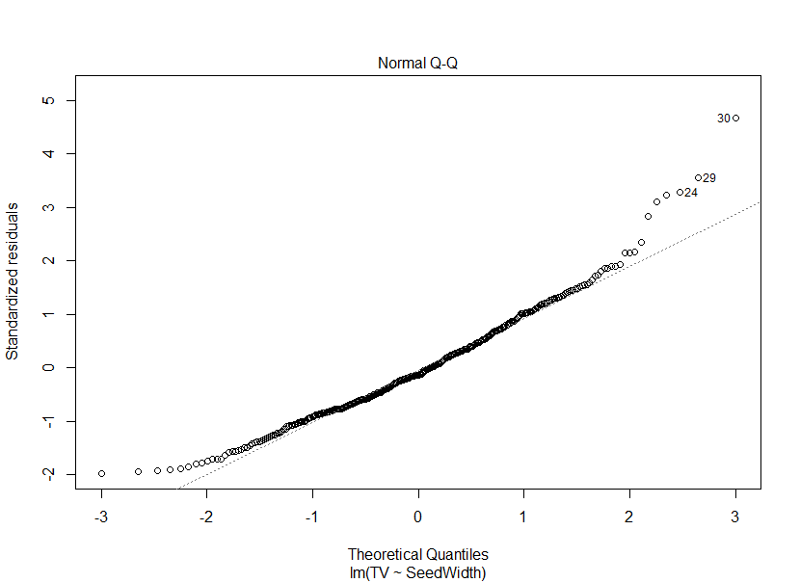
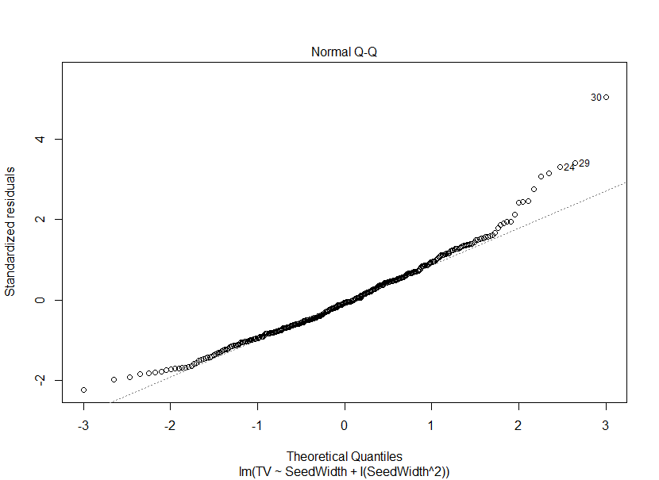
Model diagnostics
Model 3
Model 4
Normality of residuals is approximately the same, with slight deviations at tails

Slide 18
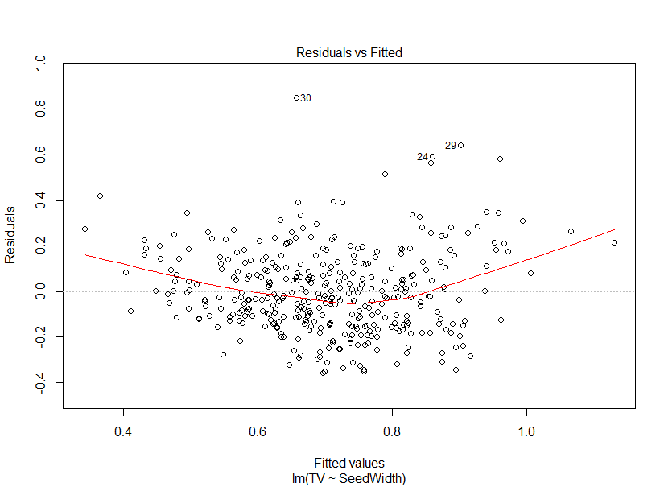
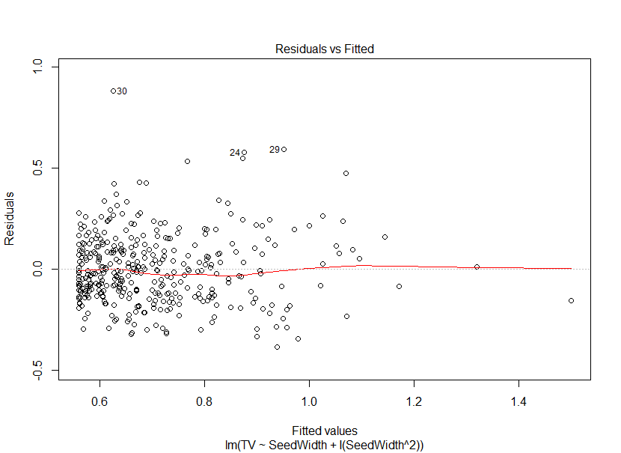
Model diagnostics
Model 3
Model 4
Curvature of residuals in model 3, but no obvious pattern in model 4

Slide 19
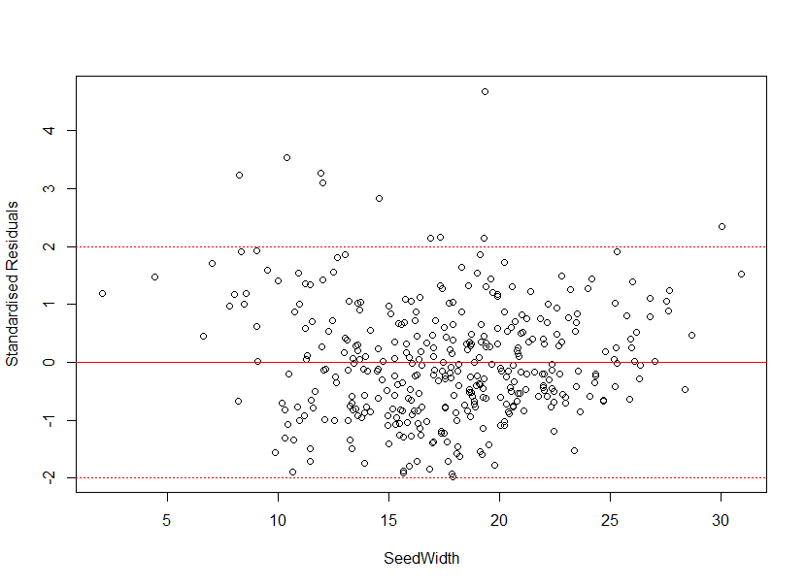
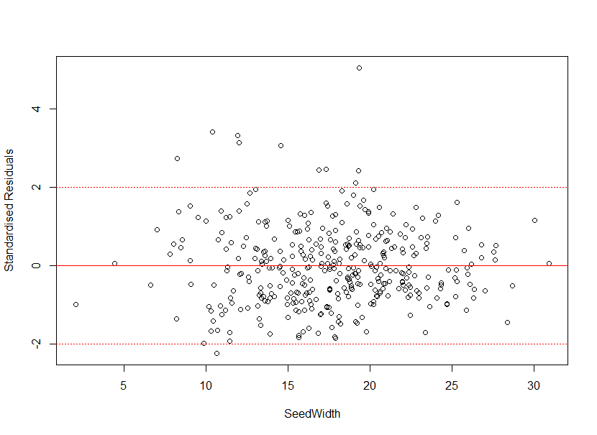
Model diagnostics
Model 3
Model 4
Curvature of residuals in model 3, but no obvious pattern in model 4

Slide 20
Conclusions
Width of the seed pappus is the best estimator of terminal velocity
As pappus width increases, terminal velocity decreases
Other predictors such as pappus height and volume add explanatory power, but not much
This is due to high multicollinearity

Slide 21
Effect of experimental treatments on terminal velocity
Research Question 2:

Slide 22
Experimental design
2 Warming Treatments
Ambient
Warmed
3 Mowing Treatments
No Mowing
Early
Late (less data)

Slide 23
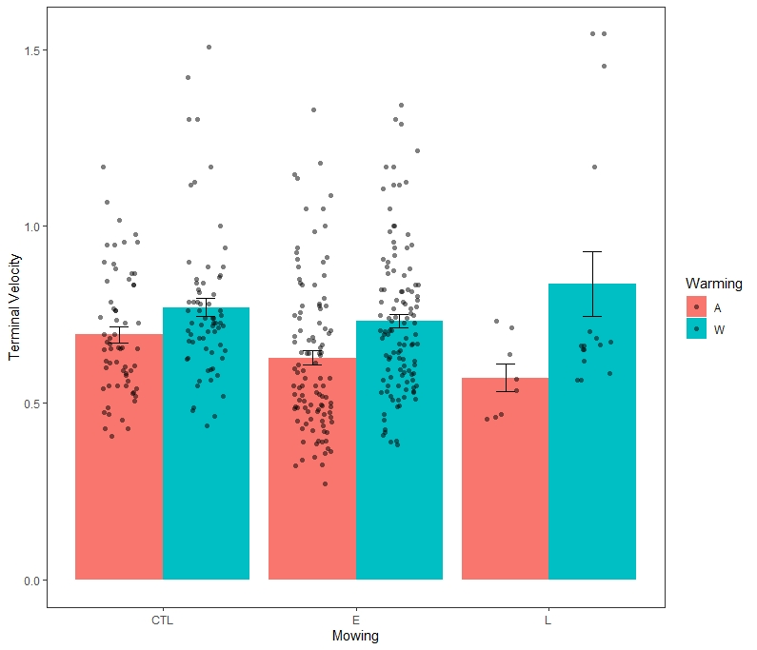
Experimental design
2 Warming Treatments
Ambient
Warmed
3 Mowing Treatments
No Mowing
Early
Late (less data)

Slide 24
Analysis approach
Fit four ANOVA models
Use model p-values to determine whether mowing only or warming only models are a better fit
Use partial F-tests to determine whether adding additional variables improves model fit
Mowing Only | Warming Only | Mowing and Warming | Mowing and Warming Interaction
$$TV= β_{0}+β_{1}Mowing+ ε$$ | $$TV= β_{0}+β_{2}Warming+ ε$$ | $$TV= β_{0}+β_{1}Mowing$$ $+β_{2}Warming+ ε$ | $$TV= β_{0}+β_{1} Mowing+β_{2 }Warming$$ $$+β_{3} Mowing∙Warming+ ε$$

Slide 25
ANOVA for warming and mowing Terminal velocity
 | Estimate
Ambient | 0.6489***
Warmed | 0.1051***
Warming Alone
 | Estimate
Control | 0.7333***
Early | -0.5124*
Late | 0.0152
Mowing Alone
 | Estimate
Ambient Control | 0.6796***
Early Mow | -0.5130*
Late Mow | -0.0005
Warmed | 0.1040***
Mowing and Warming
Significance Codes 0 *** 0.001 ** 0.05 * 0.1 .

Slide 26
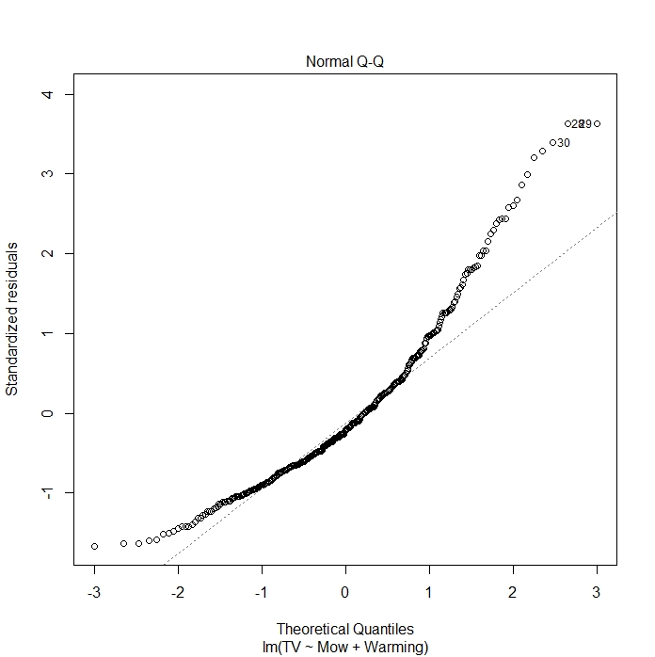
ANOVA for warming and mowing Terminal velocity
 | Estimate
Ambient | 0.6489***
Warmed | 0.1051***
Warming Alone
 | Estimate
Control | 0.7333***
Early | -0.5124*
Late | 0.0152
Mowing Alone
 | Estimate
Ambient Control | 0.6796***
Early Mow | -0.5130*
Late Mow | -0.0005
Warmed | 0.1040***
Mowing and Warming
Significance Codes 0 *** 0.001 ** 0.05 * 0.1 .

Slide 27
ANOVA for warming and mowing log(Terminal velocity)
Partial F-Test Model Selection
Model | P-value
Warming only
Warming and Mowing | 0.019*
Interaction | 0.216
Significance Codes 0 *** 0.001 ** 0.05 * 0.1 .

Slide 28
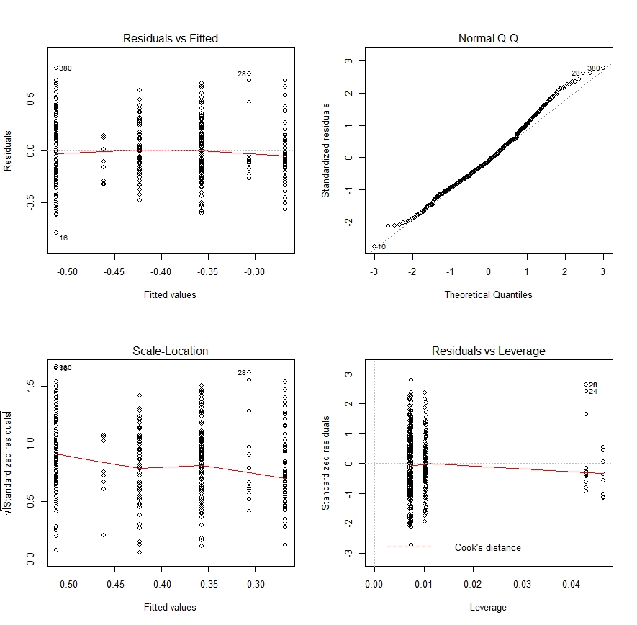
ANOVA for warming and mowing log(Terminal velocity)
Partial F-Test Model Selection
Model | P-value
Warming only
Warming and Mowing | 0.019*
Interaction | 0.216
Significance Codes 0 *** 0.001 ** 0.05 * 0.1 .

Slide 29
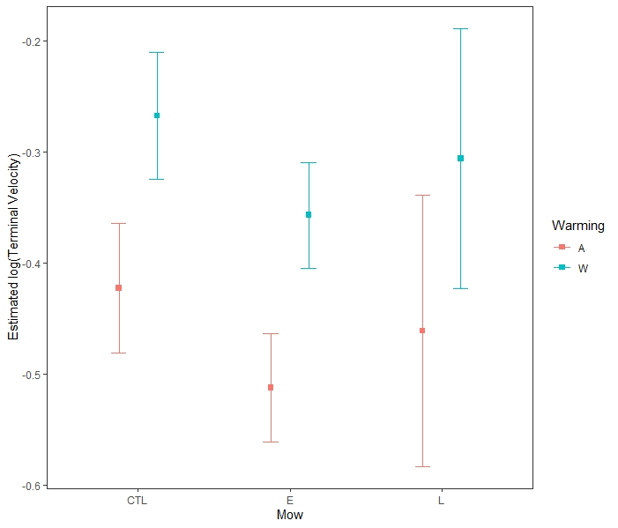
ANOVA for warming and mowing log(Terminal velocity)
Warming and Mowing Model Results
 | Estimate | Dispersal
Ambient Control | -0.423***
Early Mow | -0.089**
Late Mow | -0.038
Warmed | 0.155***
Conclusions
Both warming and mowing affect terminal velocity
Warming increases terminal velocity

Slide 30
Effect of experimental treatments on seed physical properties
Research Question 3:

Slide 31
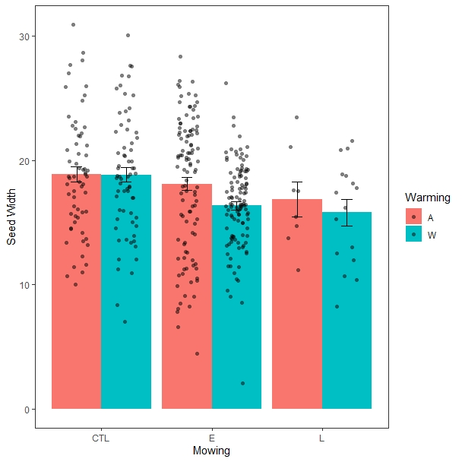
ANOVA for warming and mowing Seed Width
Significance Codes 0 *** 0.001 ** 0.05 * 0.1 .

Slide 32
ANOVA for warming and mowing Seed Width
Partial F-Test Model Selection
Model | P-value
Mowing only
Warming and Mowing | 0.018*
Interaction | 0.243
Significance Codes 0 *** 0.001 ** 0.05 * 0.1 .

Slide 33
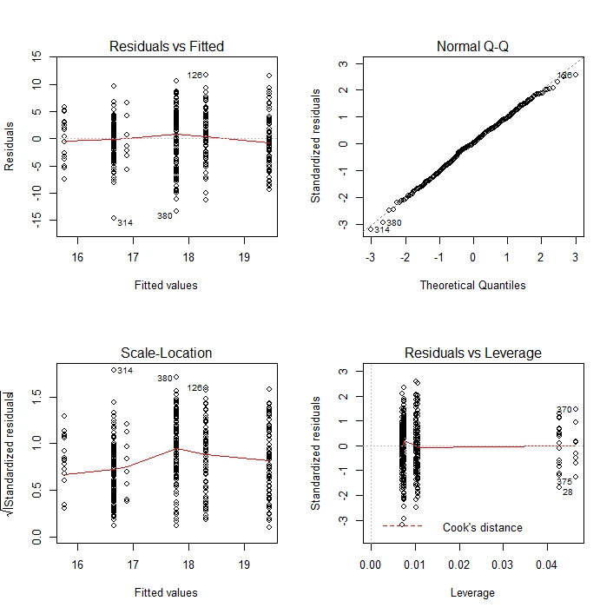
ANOVA for warming and mowing Seed Width
Partial F-Test Model Selection
Model | P-value
Mowing only
Warming and Mowing | 0.018*
Interaction | 0.243
Significance Codes 0 *** 0.001 ** 0.05 * 0.1 .

Slide 34
ANOVA for warming and mowing Seed Width
Partial F-Test Model Selection
Model | P-value
Mowing only
Warming and Mowing | 0.018*
Interaction | 0.243
Warming and Mowing Model Results
 | Estimate | TV | Dispersal
Ambient Control | 19.4443***
Early Mow | -1.6612**
Late Mow | -2.5431*
Warmed | -1.1249*
Significance Codes 0 *** 0.001 ** 0.05 * 0.1 .

Slide 35
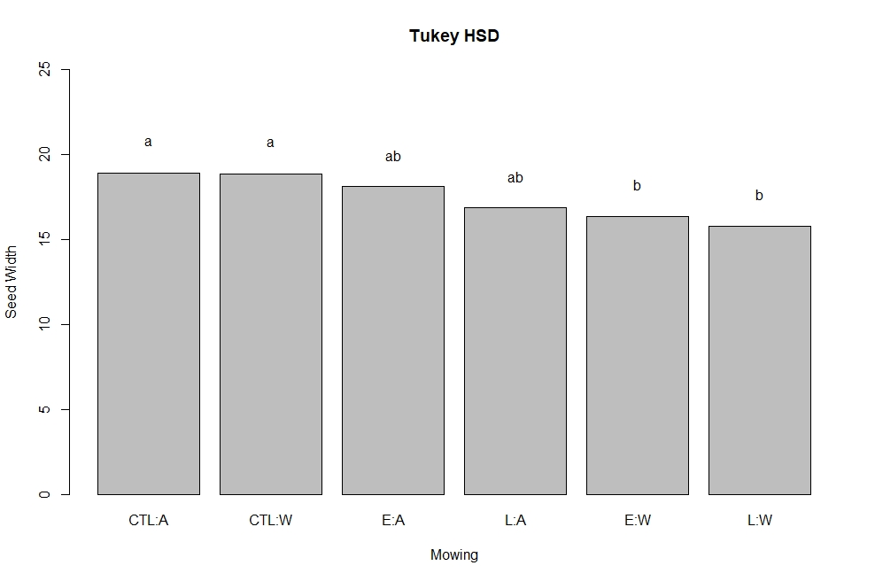
ANOVA for warming and mowing Seed Width
Pairwise comparisons performed with post-hoc Tukey HSD to identify whether certain groups are driving the observed trend
Results show control plants, regardless of warming, are significantly different than mowed plants, regardless of timing
Fit a new model with a binary mowing variable

Slide 36
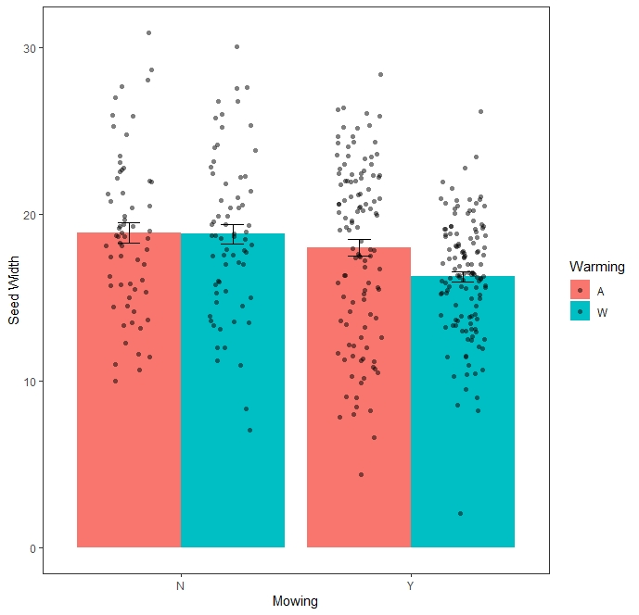
ANOVA for warming, binary mowing Seed Width
 | Estimate
Ambient | 18.3345***
Warmed | -1.1804*
Warming Alone
 | Estimate
Control | 18.8645***
Mowed | -1.7657***
Mowing Alone
 | Estimate
Ambient Control | 19.4443***
Mowed | -1.7478***
Warmed | -1.1558*
Mowing and Warming
Significance Codes 0 *** 0.001 ** 0.05 * 0.1 .

Slide 37
ANOVA for warming and mowing Seed Width
Partial F-Test Model Selection
Model | P-value
Mowing only
Warming and Mowing | 0.0154*
Interaction | 0.09.
Significance Codes 0 *** 0.001 ** 0.05 * 0.1 .

Slide 38
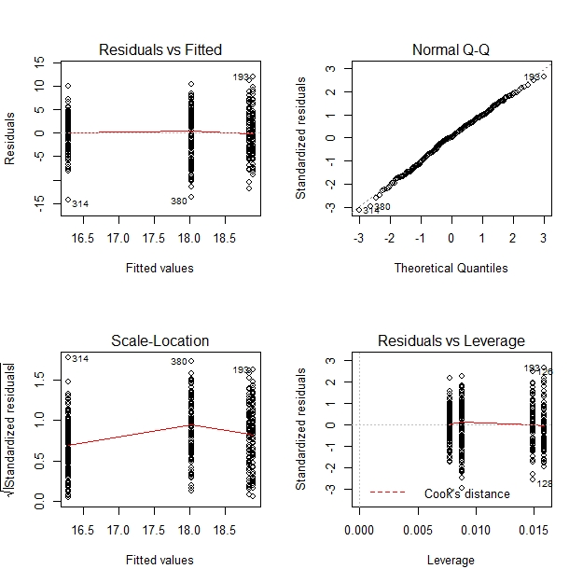
ANOVA for warming and mowing Seed Width
Partial F-Test Model Selection
Model | P-value
Mowing only
Warming and Mowing | 0.0154*
Interaction | 0.09.
Significance Codes 0 *** 0.001 ** 0.05 * 0.1 .

Slide 39
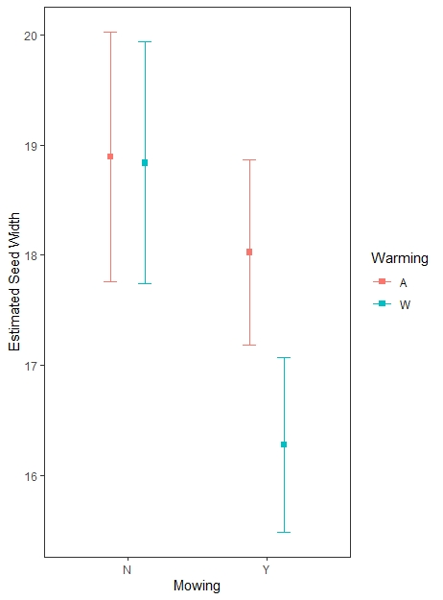
ANOVA for warming and mowing Seed Width
Partial F-Test Model Selection
Model | P-value
Mowing only
Warming and Mowing | 0.0154*
Interaction | 0.09.
Interaction Model Results
 | Estimate | TV | Dispersal
Ambient Control | 18.8923***
Mowed | -0.8665
Warmed | -0.054
Mowed and Warmed | -1.6929 .
Significance Codes 0 *** 0.001 ** 0.05 * 0.1 .

Slide 40
Conclusions
Variance in seed width does not fully explain the relationships observed in terminal velocity data
Mowing decreases seed width, which should increase terminal velocity
Previous analysis showed mowing decreased terminal velocity
The results of our experiment provide insight into how this invasive thistle will spread under future climates

